Slide 1
Chapter 3: Central Processing Unit

Slide 2
Instruction Set
The complete collection of instructions that are understood by a CPU
Machine language: binary representation of operations and (addresses of) arguments
  Assembly language: mnemonic representation for humans
  Ex: MOV R0,R1
  ADD R2,R4
  JMP LAST

Slide 3
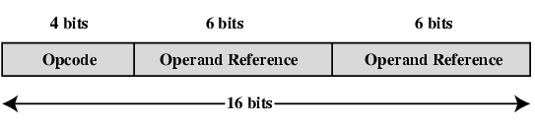
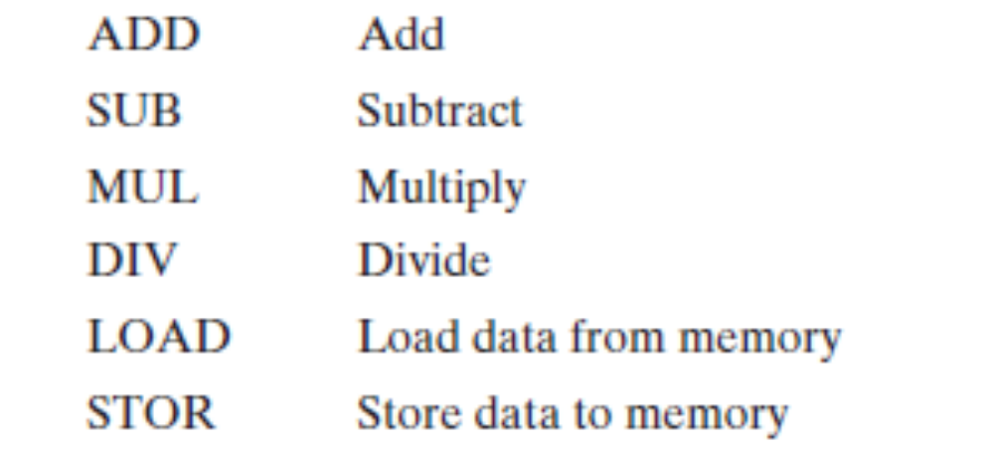
Simple Instruction Format
(using two addresses)

Slide 4
Design Decisions
Operation repertoire: How many and which operations to provide, and how complex operations should be.
Data types: The various types of data upon which operations are performed
Instruction formats: Instruction length(in bits), number of addresses, size of various fields and so on
Registers: No. of processor registers that can be referenced by instructions and so on
Addressing: The mode or modes by which the address of an operand mode is specified

Slide 5
Types of Operand
Addresses: immediate, direct, indirect, stack
Numbers: integer or fixed point (binary, twos complement), floating point (sign, significand, exponent), (packed) decimal (246 = 0000 0010 0100 0110)
Characters: ASCII (128 printable and control characters + bit for error detection)
Logical Data: bits or flags, e.g., Boolean 0 and 1

Slide 6
Instruction Types
Data transfer
Arithmetic
Logical
Conversion
I/O
System control
Transfer of control

Slide 7
Data Transfer Instruction
Store, load, exchange, move, clear, set, push, pop
Specifies: source and destination (memory, register, stack), amount of data
May be different instructions for different (size, location) movements, e.g.,
Ex:
LOAD R2, A //Loads the value from mem. loc. A to R2
STOR B, R1 // stores the contents from Reg. R1 to mem. Loc. B
XCH R0,R2 // exchanges the contents of Reg. R0 and R2
MOV R2, R4 // Copies the contents of Reg R4 into R2
CLR A

Slide 8
Arithmetic Instructions
Add, Subtract, Multiply, Divide for signed integer (+ floating point and packed decimal) – may involve data movement
Ex:
ADD R0,R2
SUB A, R4
MUL AB
DIV AB

Slide 9
Logical Instructions
Bitwise operations: AND, OR, NOT, XOR, TEST, CMP, SET
Ex:
AND A, R4
OR R2, R4
CPL A
CMP R0,R2

Slide 10
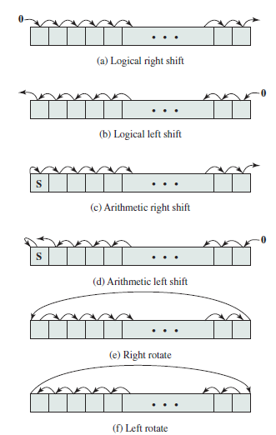
Shifting and rotating functions

Slide 11
Conversion & I/O Instructions
Change the format or operate on the format of
Data
Ex: converting from decimal to binary
Issue command to I/O module
If memory-mapped I/O, determine memory-mapped address

Slide 12
Systems Control Instructions
Privileged instructions: accessing control registers or process table
CPU needs to be in specific state
For operating systems use

Slide 13
Transfer of Control Instruction
Branch instructions: BRZ X (branch to X if result is zero), BRP X (positive), BRN X (negative), BRE X,R1,R2 (equal), skip, e.g., increment and skip if zero:
ISZ Reg1, cf. jumping out from loop
Looping instructions
Procedure (economy and modularity): call and return

Slide 14
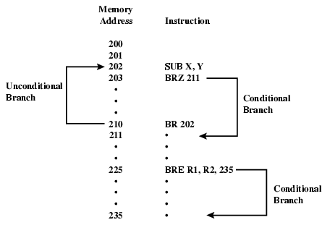
Branch Instruction

Slide 15
Instruction Formats
Layout of bits in an instruction
Includes opcode
Includes (implicit or explicit) operand(s)
Usually more than one instruction format in an instruction set

Slide 16
Number of Addresses
More addresses
  More complex (powerful?) instructions
  More registers - inter-register operations are quicker
  Less instructions per program
Fewer addresses
  Less complex (powerful?) instructions
  More instructions per program, e.g. data movement
  Faster fetch/execution of instructions
Notes:
11

Slide 17
3 addresses
Example: Y=(A-B)/[(C+(DxE)]
Operation Result, Operand 1, Operand 2
  Not common
  Needs very long words to hold everything
  SUB Y,A,B Y ← A-B
  MPY T,D,E T ← DxE
  ADD T,T,C T ← T+C
  DIV Y,Y,T Y ← Y/T
Notes:
7

Slide 18
2 addresses
One address doubles as operand and result
  Reduces length of instruction
  Requires some extra work: temporary storage
  MOVE Y,A Y <- A
  SUB Y,B Y <- Y-B
  MOVE T,D T <- D
  MPY T,E T <- TxE
  ADD T,C T <- T+C
  DIV Y,T Y <- Y/T
Notes:
8

Slide 19
1 address
Implicit second address, usually a register (accumulator, AC)
LOAD D AC ← D
MPY E AC ← ACxE
ADD C AC ← AC+C
STOR Y Y ← AC
LOAD A AC ← A
SUB B AC ← AC-B
DIV Y AC ← AC/Y
STOR Y Y ← AC
Notes:
9

Slide 20
0 (zero) addresses
All addresses implicit, e.g. ADD
  Uses a stack, e.g. pop a, pop b, add
  c = a + b
Notes:
10

Slide 21
Addressing Modes
Immediate
Direct
Indirect
Register
Register Indirect
Displacement (Indexed)
Stack
Notes:
2

Slide 22

Immediate Addressing
Ex:
ADD R2, R3,#10
ADD R5, #5
ADD #20
No memory reference to fetch data
Fast
Limited range
Notes:
3

Slide 23
Direct Addressing
Address field contains address of operand
Effective address (EA) = address field (X)
Ex:
ADD R2, R3, X
ADD R2, X
ADD X
Single memory reference to access data
No additional calculations needed to work out effective address
Limited address space (length of address field)
Notes:
5

Slide 24
Direct Addressing Diagram
Instruction
Opcode
Address A
Memory
Operand
Notes:
6

Slide 25
Indirect Addressing
Memory cell pointed to by address field contains the address of the operand
EA = (A)
  Look in A, find effective address and look there for operand
E.g. ADD (A)
  Add content of cell pointed to by content of A to accumulator
Notes:
7

Slide 26
Indirect Addressing
Large address space
2^{n} where n = word length
May be nested, multilevel, cascaded
  e.g. EA = (((A)))
Multiple memory accesses to find operand
Hence slower
Notes:
8

Slide 27
Indirect Addressing Diagram
Instruction
Opcode
Address A
Memory
Pointer to operand
Operand
Notes:
9

Slide 28
Register Addressing
Operand is held in register named in address field
EA = R
Limited number of registers
Very small address field needed
  Shorter instructions
  Faster fetch
Notes:
10

Slide 29
Register Addressing
No memory access
Very fast execution
Very limited address space
Multiple registers helps performance
  Requires good assembly programming or compiler writing – see register renaming
cf. direct addressing
Notes:
11

Slide 30
Register Addressing Diagram
Instruction
Opcode
Register Address R
Registers
Operand
Notes:
12

Slide 31
Register Indirect Addressing
Indirect addressing
EA = (R)
Operand is in memory cell pointed to by contents of register R
Large address space (2^{n})
One fewer memory access than indirect addressing
Notes:
13

Slide 32
Register Indirect Addressing Diagram
Instruction
Opcode
Register Address R
Memory
Registers
Pointer to Operand
Operand
Notes:
14

Slide 33
Displacement Addressing
EA = A + (R)
Address field holds two values
  A = base value
  R = register that holds displacement
  or vice versa
See segmentation
Notes:
15

Slide 34
Displacement Addressing Diagram
Instruction
Opcode
Register R
Address A
Memory
Registers
Displacement
+
Operand
Notes:
16

Slide 35
Relative Addressing
A version of displacement addressing
R = Program counter, PC
EA = A + (PC)
i.e., get operand from A cells away from current location pointed to by PC
cf. locality of reference & cache usage
Notes:
17

Slide 36
Indexed Addressing
A = base
R = displacement
EA = A + R
Good for iteration, e.g., accessing arrays
  EA = A + R
  R++
Sometimes automated: autoindexing (signalled by one bit in instruction)
Notes:
19

Slide 37
Stack Addressing
Operand is (implicitly) on top of stack
e.g.
  ADD Pop top two items from stack and add and push result on top
Notes:
21

